Slide 1
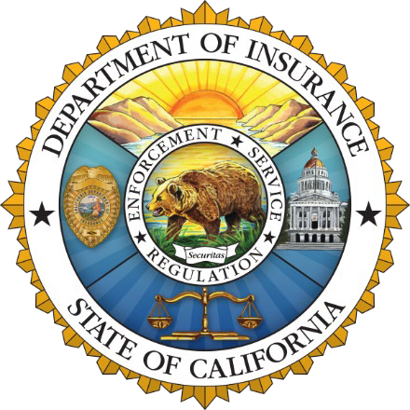
California Department of Insurance
Richie M Sayavong
Outreach Analyst
Community Relations and Outreach Branch
Notes:
Good Morning everyone thank you for the opportunity to be there. We have been meeting with many of you throughout the state and it is clear to all of us that California is at an insurance crossroads.

Slide 2
The Insurance Market
Inflation is creating unprecedented financial stress to insurance markets.
Increased costs of rebuilding, supplies, materials, auto parts along with labor shortages, among other costs, are affecting insurance markets.
Reinsurance is harder to find and is costlier as catastrophes grow around the world.
As risk grows, insurance markets are contracting to protect solvency, meet financial obligations and regulatory mandates.
Natural disasters & global inflation have increased insured losses and costs worldwide like never before.
Notes:
Natural disasters and global inflation are creating stress on insurance markets. This is not just happening here – every state is experiencing these factors:
• Increased costs for rebuilding
• Labor shortages
• Insurance for Insurance companies is harder to find and costlier
• As risk increases, insurance companies are protecting their obligations to current consumers and limiting new business

Slide 3
California Context
Top 12 Companies =
85% of State’s Homeowners Market
The property insurance market in the country (specifically in large states like California) is changing quickly.
Since 2022 alone — 7 of top 12 insurance companies have paused or restricted new business despite rate increases approved or pending with Department of Insurance.
Notes:
The property insurance market is also changing quickly.
Even though 115 insurance companies are currently selling homeowners insurance, 12 insurance groups control 85 percent of the California insurance market.
Since 2022 – 7 of the top 12 insurance groups have paused or restricted new business despite rate increases approved or pending with the Department of Insurance.
So clearly this problem is complex and global in nature – affecting us here at home

Slide 4
California Context
Insurance Group and Ranking (2022) | Market Share | 2023 Rate Increases (Pending & Approved) | Major Action Since 2022
1. State Farm | 21.22% | 28.1% | Paused new policies
2. Farmers (10 companies) | 14.9% | 17.7%, 12.5% | Limited new policies to 7,000 per month
3. CSAA (2 companies) | 6.9% | 18.55% (approved 2021)
4. Liberty Mutual (6 companies) | 6.6% | 29%, 10.6%
5. Mercury | 6% | 12.6%, 7%
6. Allstate (5 companies) | 6% | 39.6% | Paused new policies
7. USAA (4 companies) | 5.7% | 30.6%, 16.5%, 6.9%, 3% | Restricted underwriting to low-risk only
8. Auto Club | 5.1% | 20%
9. Travelers | 4.2% | 21.7% | Limited new policies
10. American Family (3 companies) | 2.8% | 22.7%, 6.9%, 6.9%
11. Nationwide (2 companies) | 2.5% | 19.9%, 24.5% | Limited new policies
12. Chubb (8 companies) | 2.2% |  | Ceased writing high-value homes with higher wildfire risk, and non-renewed some high-value homes
Notes:
This slides shows you that 7 of these 12 insurance companies have either paused or restricted their new policies even though most have pending or approved rate increases showing that the problem cannot be solved by just increasing prices.

Slide 5
California Context
Over past 10 years, homeowners insurance companies have done far worse in California than nationally.
Direct incurred loss ratio (2012-2021) Countrywide: 59.7% California: 73.9%
Direct underwriting profit Countrywide: 3.6% California: -13.1%
Direct profit on insurance transactions: Countrywide: 4.2% California: -6.1%
Direct return on net worth: Countrywide: 7% California: 0.8%
Source: NAIC Profitability Report (released January 2023)
Notes:
Over the past 10 years insurance companies have done far worse in California than nationally – by any measure.
During those years California experienced 9 of the 10 most devastating wildfires in our state’s history.
As a result, we are faced with a tough question: Can consumers get insurance they need?
Today the answer is generally, no.
Because climate change impacts are accelerating we need to take actions that expand insurance availability.

Slide 6
How did we get here?
FAIR Plan has increased to 3% of CA market – becoming the insurer of first resort, not last resort, for many.
AM Best downgraded outlooks for Top-12 companies like State Farm, AAA, Mercury due to risk concentration in California.
Insurance companies will not write in high-risk areas, unless they can cover 100% of consumer claims, their expenses, and earn a fair return.
Rate filings are more complex and can take longer than 6 months to review.
One entity can unreasonably prolong rate filings – no other state has this.
Notes:
Since Commissioner Lara took office in 2019, we have been consistently monitoring and analyzing the status and direction of insurance availability trends.
The FAIR Plan has doubled to 3% of the market — becoming the insurer of first resort for many Californians, not the last resort as it was designed. The FAIR Plan is not a state agency, it is run and funded by the insurance companies.
A growing FAIR Plan is a problem, because FAIR Plan policyholders are required to pay more for less coverage, and concentrating the highest risk properties under the FAIR Plan increases the chance that it will be unable to afford a catastrophic disaster.
It’s really important to understand this point … if the FAIR Plan goes insolvent, insurance companies are on the hook for the unpaid FAIR Plan losses. While this hasn’t happened in nearly 30 years, the uncertainty is still driving insurance companies to further limit coverage to at-risk Californians.
A growing FAIR Plan creates risk for the entire insurance market.
As a direct result of growing risk concentration in California, the credit rating agency AM Best has downgraded outlooks for Top-12 companies like State Farm, AAA and Mercury.
And there is a critical fact to know: Unlike public utilities, which are required to provide coverage to all residents and businesses, under Proposition 103 insurance companies can legally refuse to write insurance unless they are able to meet 100% of consumers’ claims, cover their expenses and earn a fair return.
Everyone is harmed if an insurance company goes insolvent because it cannot pay its claims. And we want to make sure that does not happen

Slide 7
Safer From Wildfires
Protect your home or business
+
Protect the immediate surroundings
+
Protect the whole community
Notes:
To reduce the risk of major losses in the industry Commissioner Lara introduced the Safer from Wildfires framework
It is a three step system to protect your home, surroundings and community which in turn provides consumers with discounts and transparency about your risk rating.
Under this regulation we expect to see:
More businesses, homeowners and communities making investments in wildfire safety
Greater community resilience
Reduced losses from wildfires
More insurance coverage for mitigated properties
It is important to note that CDI does not have the authority to force insurers to write coverage.
This regulation attacks the root cause of non-renewals – which is wildfire risk – and they will make Californians safer.
And with accurate pricing of insurance, we expect to see more insurance options for people through a more competitive market.

Slide 8
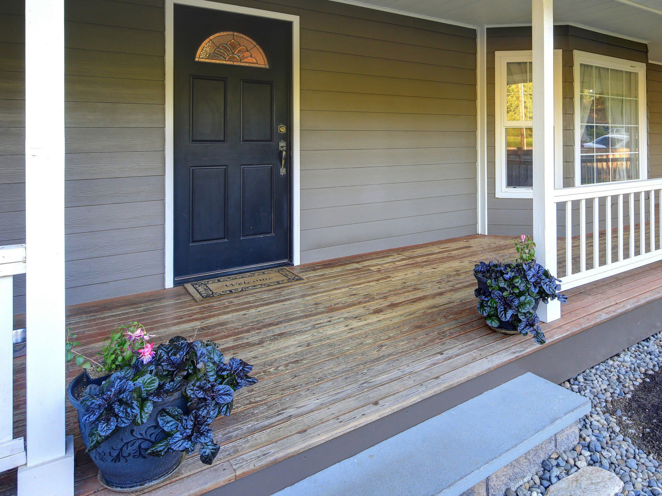
Protect your
home or business
Class A fire-rated roof
5-foot ember-resistant zone around the structure
Noncombustible 6 inches at the bottom
Ember- and fire-resistant vents
Double pane windows or added shutters
Enclosed eaves
of walls
Notes:
Step One is pretty straight forward, Class-A Fire Rated Roof, Enclosed Eaves, Fire-Resistant Vents, Multi-pane windows and a minimum of 6” noncombustible vertical clearance at the bottom of the exterior surface of the structure.

Slide 9
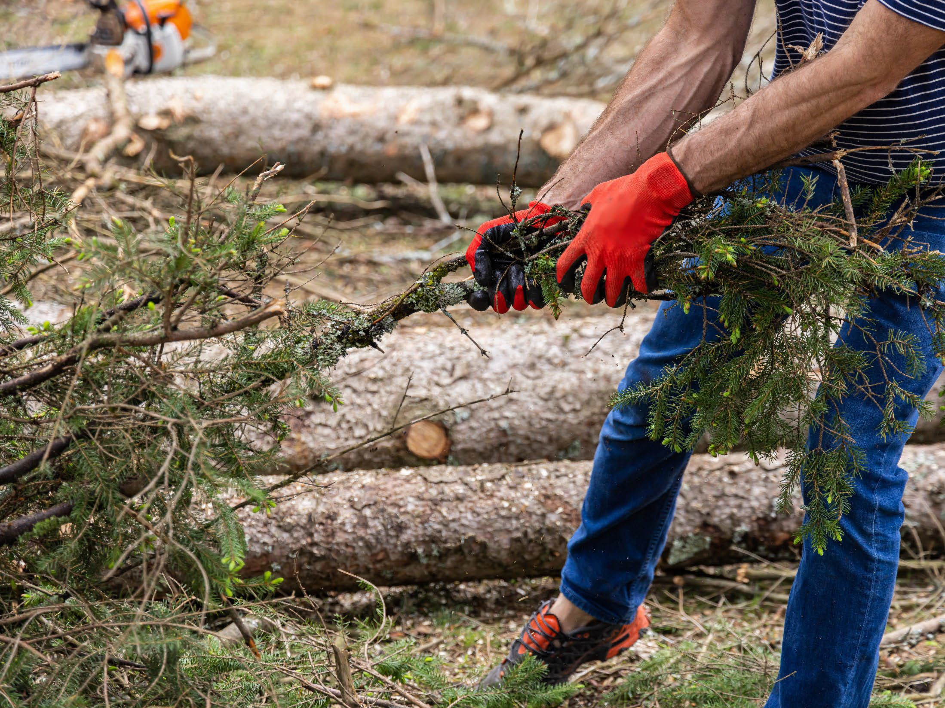
Protect the
immediate surroundings
Cleared vegetation and debris from under
Move sheds and outbuildings at least 30 feet away
Trim trees and remove brush in compliance with state and local defensible space laws
decks
Notes:
Step Two – protect the immediate surroundings. 1.Clearing of vegetation and debris from under decks.
2. Clearing of vegetation, debris, mulch stored combustible materials, and any and all movable combustible materials from within 5 feet of the Building Being Evaluated (BBE).
3. Incorporation of only noncombustible materials into that portion of any improvements to the property of BBE which is situated within 5 feet of the BBE.
4. Removal of combustible structures, sheds and other outbuildings from the immediate surroundings of the home, to at least a distance of 30 feet.”

Slide 10
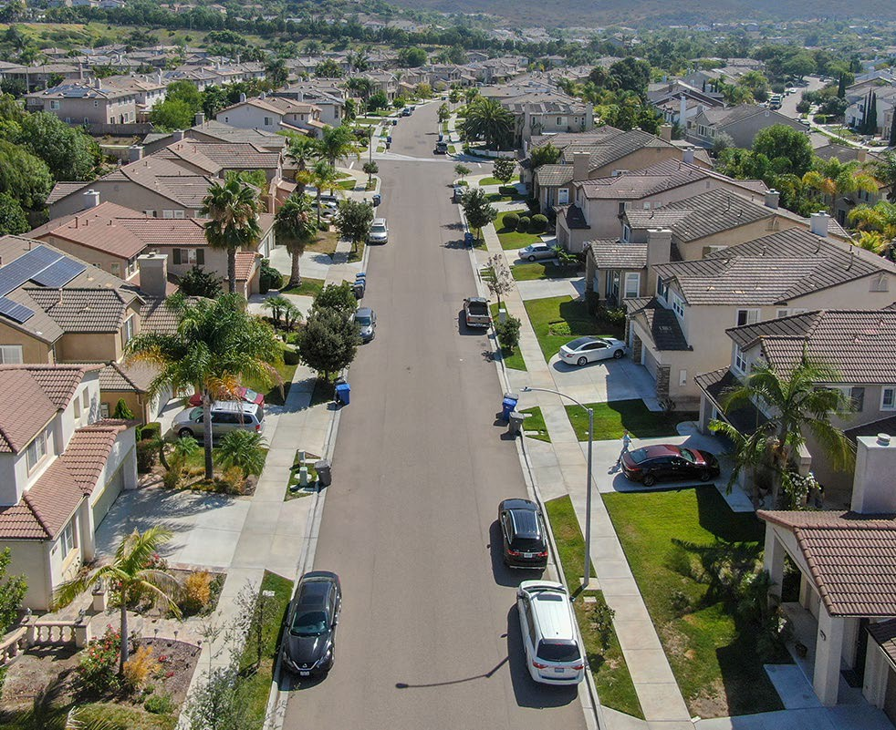
Protect the
whole community
•
•
Neighborhoods can form a Firewise USA community
Cities, counties, and local districts can become certified as a Fire Risk Reduction Community
Notes:
And finally step three is an effort to obtain a community-level mitigation designation. This will most likely involve at least one, if not more, local government agencies (Fire, Emergency Services, Planning, etc.). Community-level mitigation designates include: FRRC by the Board of Forestry (PRC Section 4290.1), and a Firewise USA site in Good Standing. The Firewise Program is nationwide program created by the National Fire Protection Association. California has more than 700 Firewise USA communities with more forming – and it is an important part of California’s efforts to ensure communities are prepared against wildfire.

Slide 11
CA FAIR Plan & Wildfire Risk Score
Since August the CA FAIR Plan began offering insurance discounts
The CA FAIR Plan is offering 20 million dollar coverage per location for commercial policies, including HOAs
The Wildfire Risk Score regulations allow consumers to request and appeal your property risk score
Notes:
The CA FAIR Plan began offering insurance discounts starting August 23rd , and CDI expects to have other companies approved by the end of the year. The FAIR Plan has offered a 10% discount on policies in a participating Firewise Community since May 2018. Now, the FAIR Plan is offering two more wildfire hardening discounts: one for Protecting the Structure, and another for Protecting the Immediate Surroundings of the dwelling. When applied, these discounts will reduce the wildfire portion of the policy’s premium by 10% and 5% respectively. Depending on your level of wildfire risk, this can be a large component of your overall premium. Contact your broker to find out what this means for your premium, how to qualify, and when you could receive a discount.
CDI and the CA FAIR Plan reached an agreement to increase the commercial coverage limit to $20 million per location (effective November 1, 2023). This addresses the greater needs for recreational youth camps, homeowners’ associations, wineries, and agricultural groups for additional coverage. And the business owner’s policy (BOP) limit increase to $20M is to take effect no later than December 14th, sooner if FAIR Plan is able to implement earlier.
Another thing I would like to discuss is most people do not know that insurance companies assign a risk score to your home or business. People are hungry for this information – because if you know about the risks on your property, you can take action to reduce them and make yourself and your neighbors safer.
This Regulation requires insurance companies to give you the wildfire risk score for your property. They have to tell you how they created that score and what factors went into the score.
The wildfire risk score or classification must be provided to you at the following times:
When you apply for a new policy (within 15 days)
Before you renew a policy (at least 45 days)
Before you are non-renewed (at least 75 days)
When you complete mitigation on your property and request a revised score (within 30 days)
By creating a right of appeal the Regulation is giving power back to consumers. And if you are not satisfied with the response, the Department of Insurance is on your side to help.

Slide 12
Major Actions Taken to Date
Wildfire Response:
First-in-the-nation “Safer From Wildfires" regulation created community wide mitigation standards and “Insurance Discounts” for consumers and businesses who harden their properties.
Allowed consumers to obtain their fire risk score from insurance companies and appeal their scores due to their mitigation efforts.
Expanded FAIR Plan insurance coverage to $20 million per location.
Modernized FAIR Plan to provide consumers with more options.
Climate Response:
Created first “Climate and Sustainability Branch” in country.
Established “Climate Insurance Working Group” generating CA’s first-ever Climate Insurance Report.
Partnered with United Nations to launch “CA’s Sustainable Insurance Roadmap”.
Notes:
And it’s important to understand that we are not starting from scratch.
These actions build on changes the Commissioner has made since 2019 moving in the direction of a more modern and resilient market.
We have moved forward on wildfire actions and are responding to climate change like never before. We are proud the Department is leading the way for our state and our nation.

Slide 13
Modernizing Our Insurance Market:
Accessible Insurance for Californians
+
Create a Resilient Insurance Market
+
Protect Communities from Climate Change
Notes:
California’s Sustainable Insurance Strategy is a comprehensive plan to modernize our insurance market with three interlocking goals:
• Making insurance available to Californians
• Creating a resilient insurance market
• Protecting communities from climate change

Slide 14
California Sustainable Insurance Strategy
Insurance Availability in At-Risk Areas — Requiring insurance companies to write no less than 85% of homes and businesses in distressed areas identified by Insurance Commissioner.
Returning FAIR Plan Policyholders to Market — With first priority given to homes and businesses following “Safer from Wildfires” regulation.
Cat Models/Mitigation — New models will recognize mitigation and hardening requirements to appropriately price rates and discount benefits; presently not available in current rate making process today.
California-only reinsurance costs — Protecting consumers from paying for other global catastrophes.
Modernizing FAIR Plan — Expanding commercial coverage limits to $20 million per structure closes coverage gaps for HOAs, affordable housing, and infill developments.
Notes:
Here are the executive actions and reforms Commissioner Lara is taking:
One -- we will increase availability of insurance in wildfire distressed areas. Using our prior approval rate authority, insurance companies will write no less than 85 percent of homes and businesses in wildfire distressed areas. This is a historic agreement between the Department and insurance companies.
We will reverse the trend of a growing FAIR Plan and closing the insurance gap.
The Department will define these distressed areas using a data-driven approach.
The second important part of this plan is … we will return FAIR Plan policyholders back to traditional insurance — with first priority given to hardened homes and businesses following the “Safer from Wildfires” regulation.
The next important element of the plan directly addresses the climate crisis.
The Commissioner will introduce regulations to utilize forward-looking catastrophe models prioritizing wildfire safety, mitigation, and transparency.
Effectively addressing climate change requires new risk assessment strategies that keep insurance available.
Forward-looking models must recognize the clear benefits of investments our Governor and Legislature are making in wildfire
safety – including home hardening, fuel reduction, and prescribed fire.
We have a clear template for how to do this – in the “Safer From Wildfires” regulation requiring insurance discounts and increased transparency on wildfire risk scores.
We will take input from the public and put the public’s interest in safety and insurance access first as we did in that process.
As another important element of stabilizing our marketplace in the face of climate change…
We will also explore allowing California-only reinsurance costs. Reinsurance is a tool that many insurance companies are using to manage their climate risk and continue writing policies.
We want to underscore that Californians will not pay the costs of hurricanes, fires, and floods across the nation and around the world.
Under Commissioner Lara’s agreement, companies wishing to use these new risk assessment tools must agree to increase and maintain their writing in the wildfire distressed areas of our state. That’s the 85 percent requirement we just talked about – increasing writing and removing people from the FAIR Plan.
Turning to the FAIR Plan – we will continue modernizing the FAIR Plan by expanding commercial coverage limits to $20 million per structure.
This closes coverage gaps for HOAs, affordable housing, infill developments, agribusiness – who also have been having a hard time finding coverage.

Slide 15
The largest insurance reform since voters passed Proposition 103 in 1988 —
informed by thousands of
CONSUMERS in every county.
Commissioner Lara and Department of Insurance Outreach Teams have met with more than 122,000 consumers in person and virtually since 2019.
More than 2000 meetings, town halls, and events in all 58 counties of the state.
Notes:
Our California Sustainable Insurance Strategy is the result of meeting with California homeowners, business owners, fire chiefs, agents, realtors, homeowners associations, summer camps, farmers and ranchers, and many other insurance consumers across this state.
We have held meetings in all 58 counties since 2019 making sure we are taking everyone in to account. The issue of insurance availability is imperative for everyone and we will do our part to improve the market. Help us do your part by being Safer from Wildfires.

Slide 16
Questions?
1-800-927-4357
insurance.ca.gov

